Slide 1

Introduction to CUDA (1) Getting Started
Parallel Computing

Slide 2
Content
1. CUDA Overview
2. CUDA Programming model

Slide 3
What is CUDA
Compute Unified Device Architecture
CUDA是由NVIDIA创建的并行计算平台和编程模型。
迄今为止，CUDA的下载量已超过2000万次，它通过利用GPU加速器的强大能力，帮助开发者加速其应用程序的运行。
众多开发者已通过这种方式加速了他们对计算和带宽需求极高的应用程序，包括支撑当前人工智能革命——即深度学习——的库和框架。

Slide 4
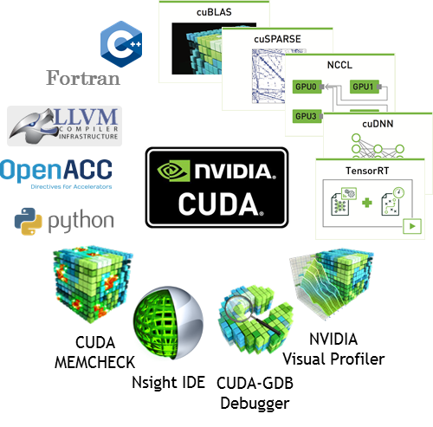
What is CUDA

Slide 5
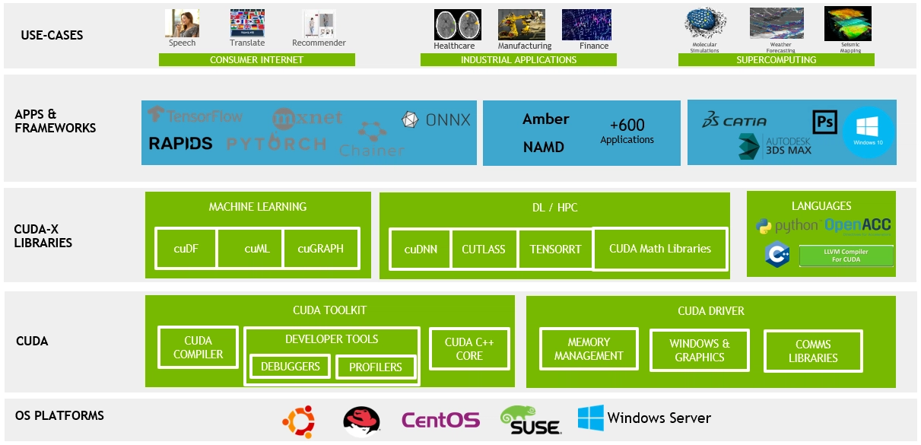
What is CUDA

Slide 6
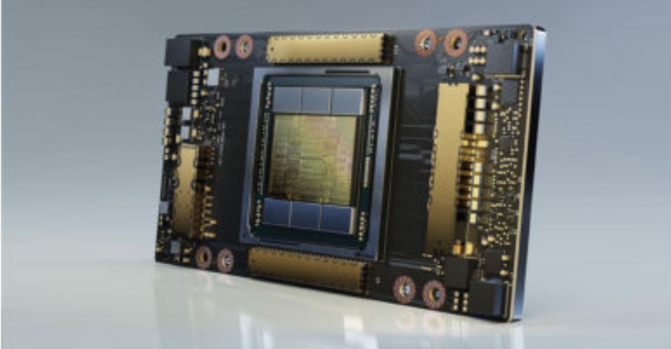
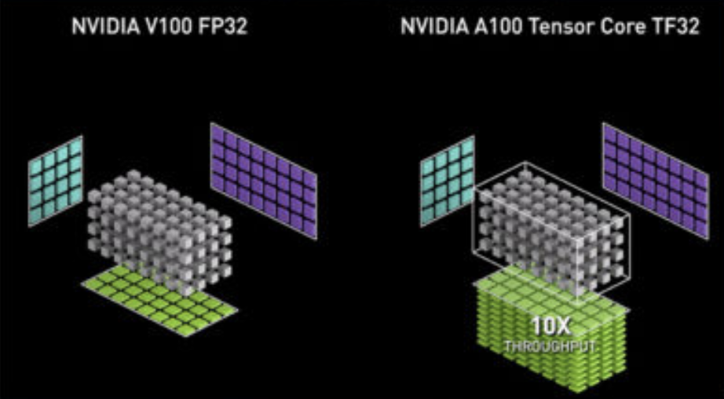
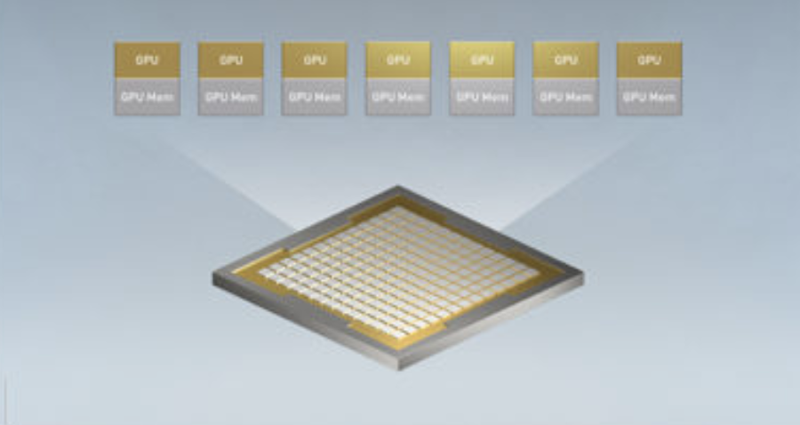
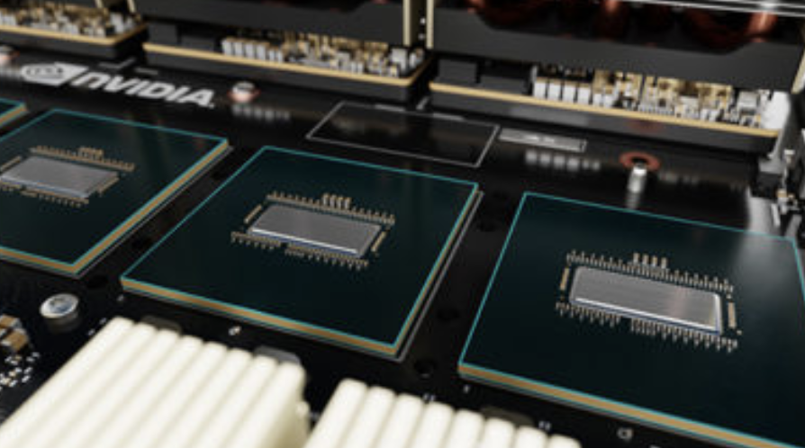
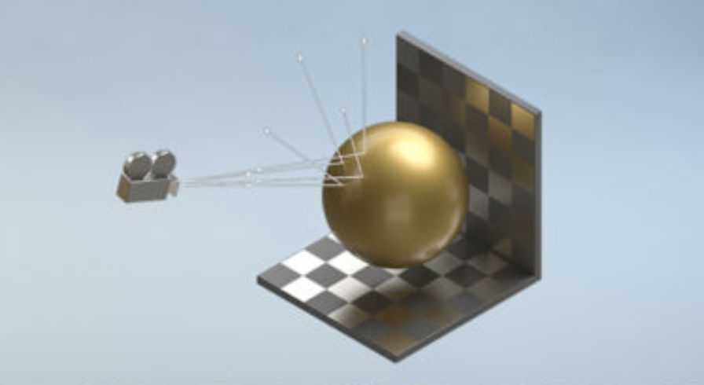
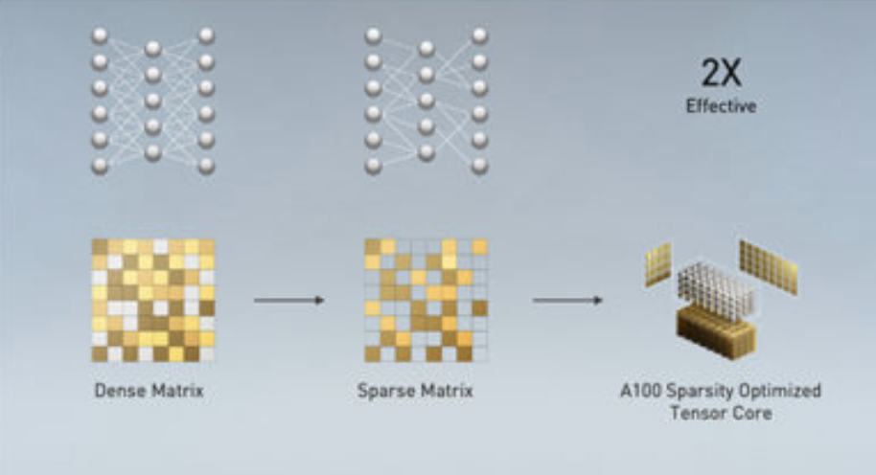
What is CUDA
The NVIDIA Ampere GPU, MIG, Tensor Cores, RT Cores, structural sparsity, and NVLink.

Slide 7
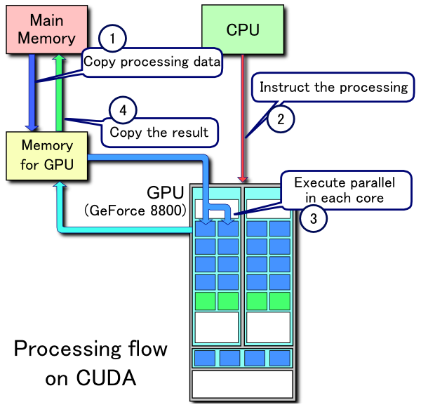
What is CUDA

Slide 8
CUDA并行计算
C/C++
Computer with an CUDA-capable GPU
Windows, Mac, or Linux,
NVIDIA GPUs
Cloud instance with GPUs (AWS, Azure, IBM SoftLayer...)
... CUDA Toolkit

Slide 9
CUDA Toolkit
NVIDIA® CUDA® 工具包为创建高性能GPU加速应用程序提供了一个开发环境。
支持以下平台开发、优化和部署应用程序:
GPU加速的嵌入式系统 / 桌面工作站
企业数据中心 / 云平台
高性能计算（HPC）超级计算机。
支持跨多个领域的即插即用加速:
线性代数、图像和视频处理
深度学习、图分析

Slide 10


CUDA Toolkit
Components

Slide 11
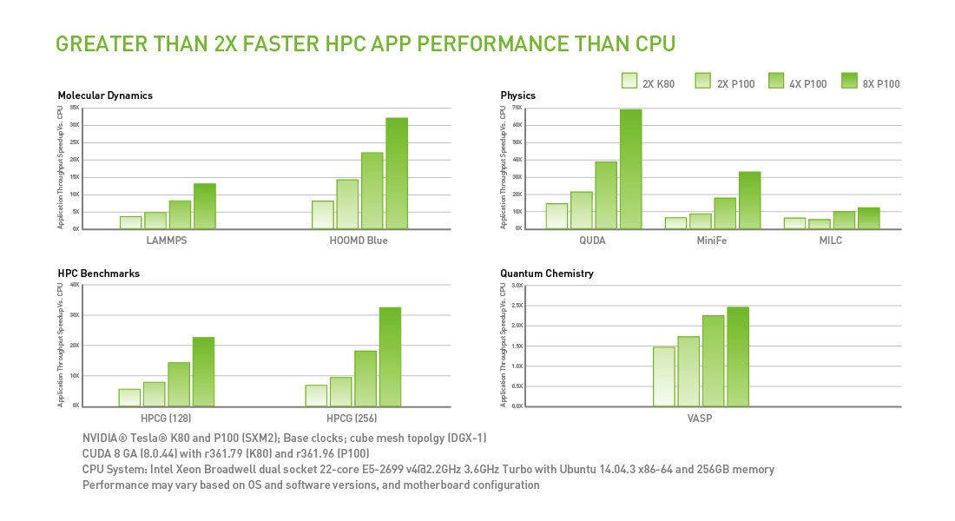
CUDA Toolkit
High Performance

Slide 12
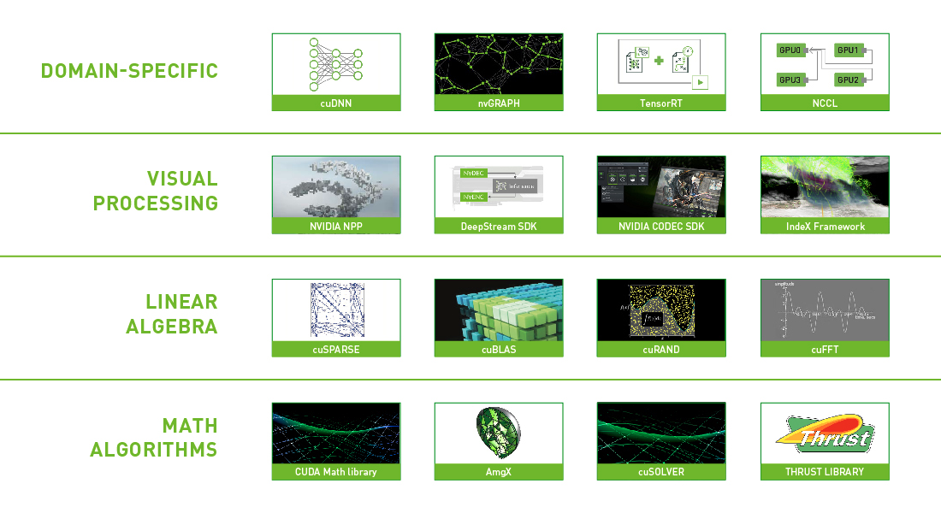
CUDA Toolkit
Domain Specific Libraries

Slide 13
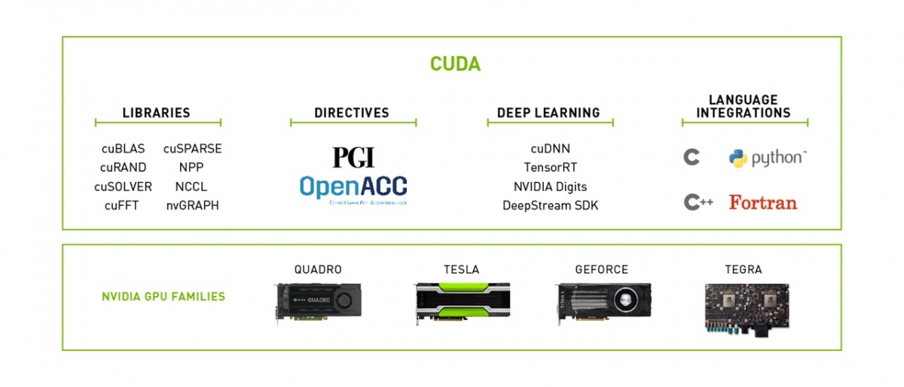
CUDA Toolkit
Develop Once, Deploy Everywhere

Slide 14
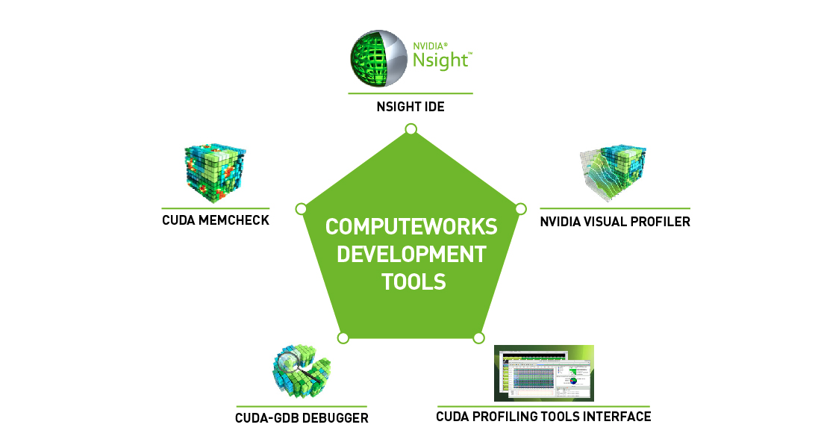
CUDA Toolkit
Integrated Development Environment

Slide 15
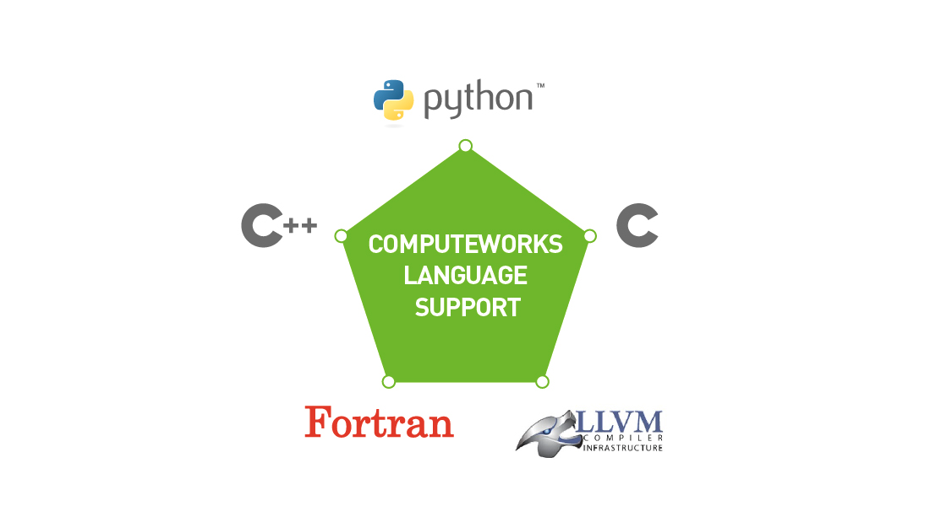
CUDA Toolkit
Language Integration

Slide 16
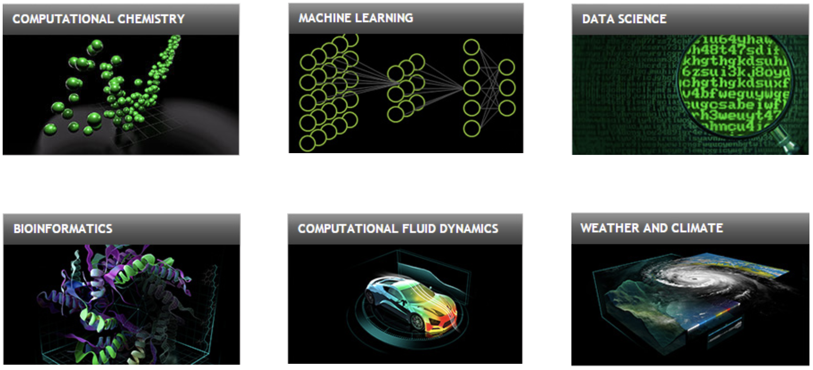
CUDA Toolkit
Applications

Slide 17

CUDA Toolkit
Built-in integration

Slide 18
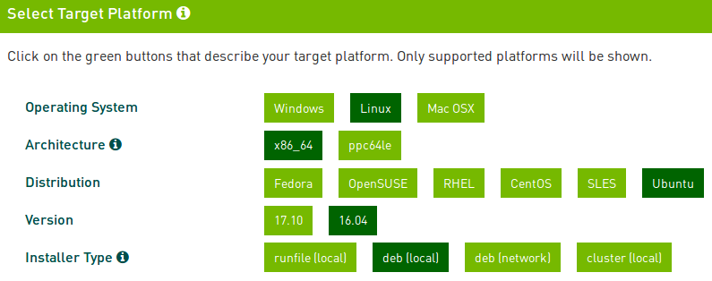
CUDA Download

Slide 19
CUDA Pre-Installation
Verify You Have a CUDA-Capable GPU
$ lspci | grep -i nvidia
Verify You Have a Supported Version of Linux
$ uname -m && cat /etc/*release
Verify the System Has gcc Installed
$ gcc --version
Verify the System has the Correct Kernel Headers and Development Packages Installed
$ sudo apt-get install linux-headers-$(uname -r)
NVIDIA CUDA Installation Guide for Linux.
https://docs.nvidia.com/cuda/cuda-installation-guide-linux/index.html

Slide 20
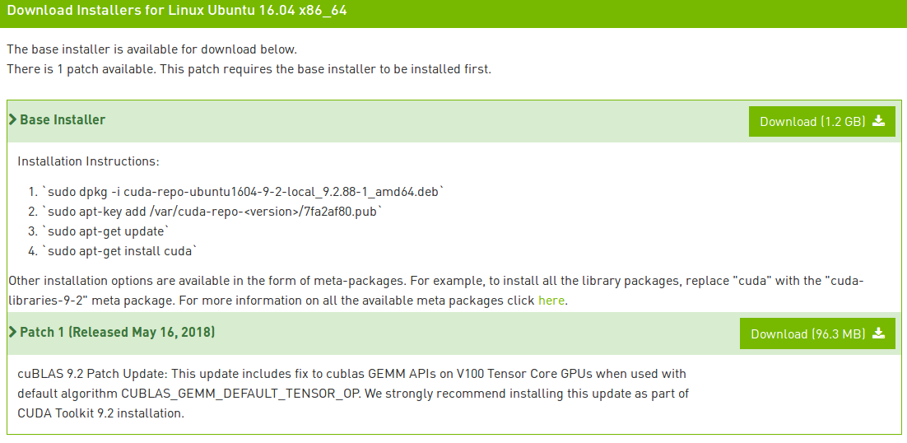
CUDA Installation

Slide 21
CUDA Post-Installation
Environment Setup
export PATH=/usr/local/cuda-9.2/bin${PATH:+:${PATH}}
export LD_LIBRARY_PATH=/usr/local/cuda-9.2/lib64${LD_LIBRARY_PATH:+:${LD_LIBRARY_PATH}}
CUDA Samples
https://github.com/NVIDIA/cuda-samples (版本12之后)
$ cd <sample_dir>
$ make

Slide 22
CUDA Verification
Verify the Driver Version
$ cat /proc/driver/nvidia/version
Compiling the Examples
Go to ~/NVIDIA_CUDA-9.2_Samples and typing make.
The resulting binaries will be placed under ~/NVIDIA_CUDA-9.2_Samples/bin.
Running the Binaries
under ~/NVIDIA_CUDA-9.2_Samples
Find and run deviceQuery.

Slide 23
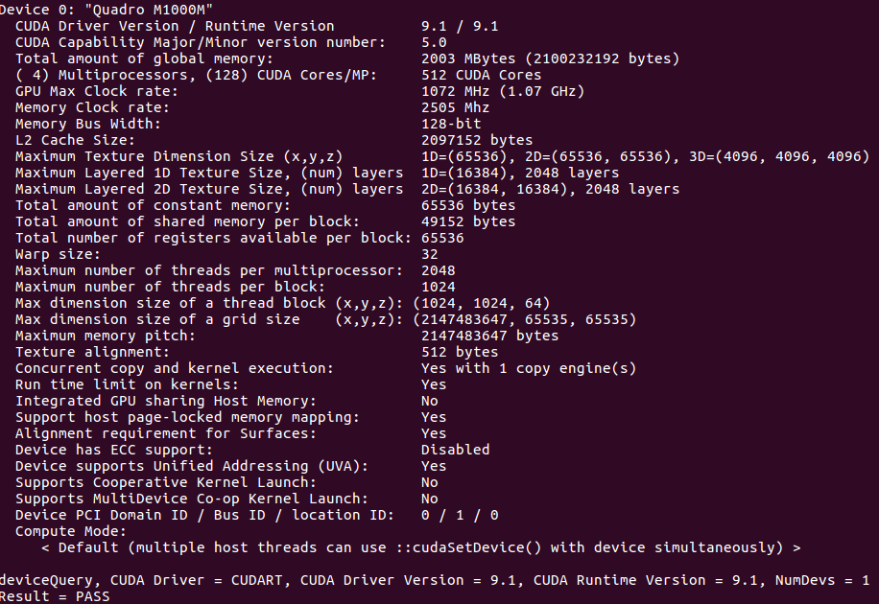
CUDA Verification

Slide 24
Content
1. CUDA Overview
2. CUDA Programming model

Slide 25
DATA PARALLELISM
通常情况下，数据量过大会导致软件运行缓慢:
消费级应用程序处理图像或视频，涉及数百万到数万亿像素。
科学应用程序使用数十亿网格单元模拟流体动力学。
分子动力学应用程序必须模拟数千到数百万原子之间的相互作用。
航空公司调度涉及数千个航班、机组人员和机场登机口的安排。

Slide 26
DATA PARALLELISM
独立性
这些应用场景中，像素处理、粒子、细胞之间的相互作用、航班调度等
大多数可以在很大程度上独立处理。
独立性评估是数据并行性的基础：
围绕数据（重新）组织计算
独立的任务可以并行执行。

Slide 27

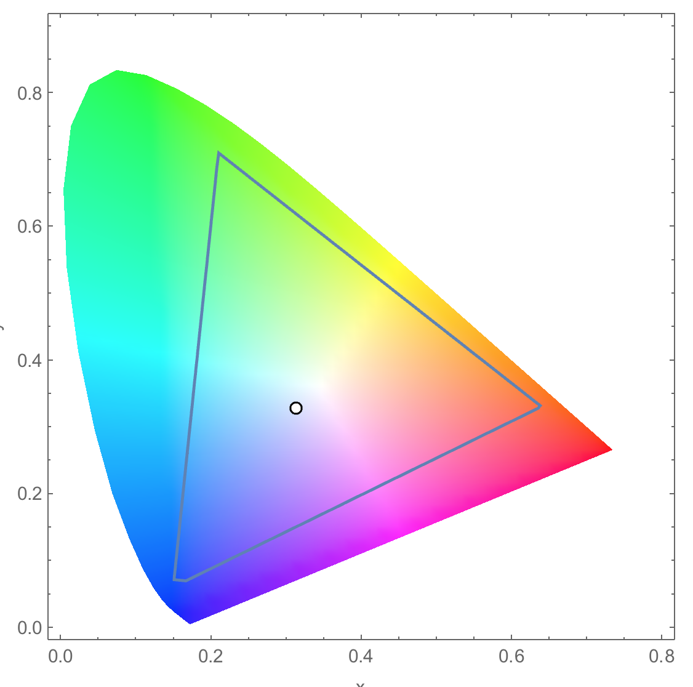
Example of data parallel
Conversion of a color image to grey–scale image
AdobeRGB color space

Slide 28
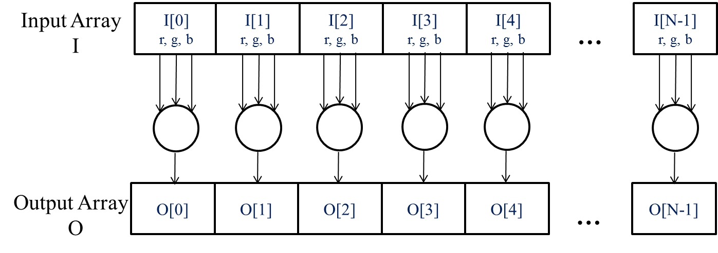
像素可以相互独立地进行计算
The pixels can be calculated independently of each other during colour to greyscale conversion.

Slide 29
colorToGreyscaleConversion ‘Preview’
// we have 3 channels corresponding to RGB
// The input image is encoded as unsigned characters [0, 255]
__global__
void colorToGreyscaleConvertion(unsigned char * Pout, unsigned char * Pin,
int width, int height) {
int Col = threadIdx.x + blockIdx.x * blockDim.x;
int Row = threadIdx.y + blockIdx.y * blockDim.y;
if (Col < width && Row < height) {
// get 1D coordinate for the grayscale image
int greyOffset = Row*width + Col;
// one can think of the RGB image having
// CHANNEL times columns of the gray scale image
int rgbOffset = greyOffset*CHANNELS;
unsigned char r = rgbImage[rgbOffset ]; // red value for pixel
unsigned char g = rgbImage[rgbOffset + 1]; // green value for pixel
unsigned char b = rgbImage[rgbOffset + 2]; // blue value for pixel
// perform the rescaling and store it
// We multiply by floating point constants
grayImage[grayOffset] = 0.21f*r + 0.71f*g + 0.07f*b;
}
}

Slide 30
Content
Data Parallelism
Example – color to grey conversion
CUDA Programming model
CUDA C Structure
Example – vector add
Memory and Data Transfer
Kernel Function
Kernel Launch

Slide 31
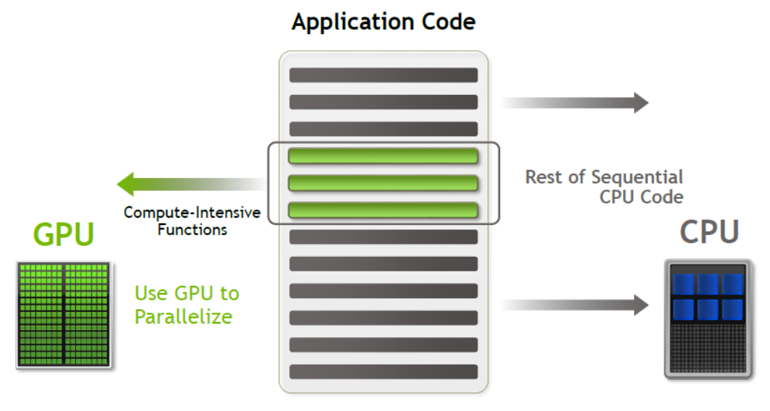
Heterogeneous parallel computing
device
host

Slide 32
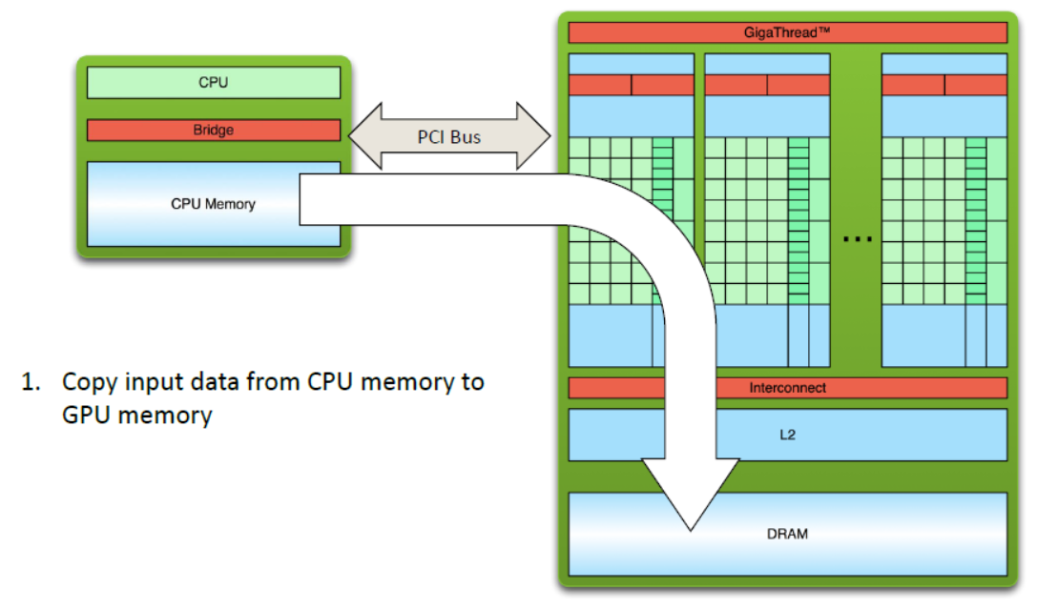
Heterogeneous parallel computing

Slide 33
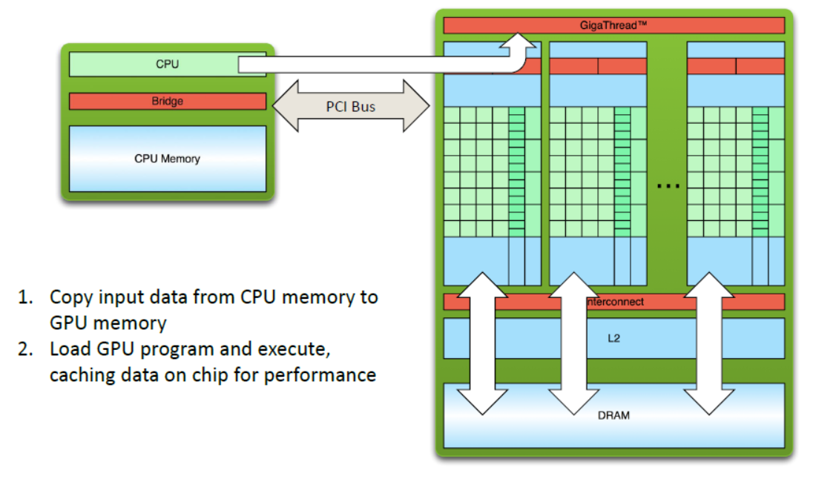
Heterogeneous parallel computing

Slide 34
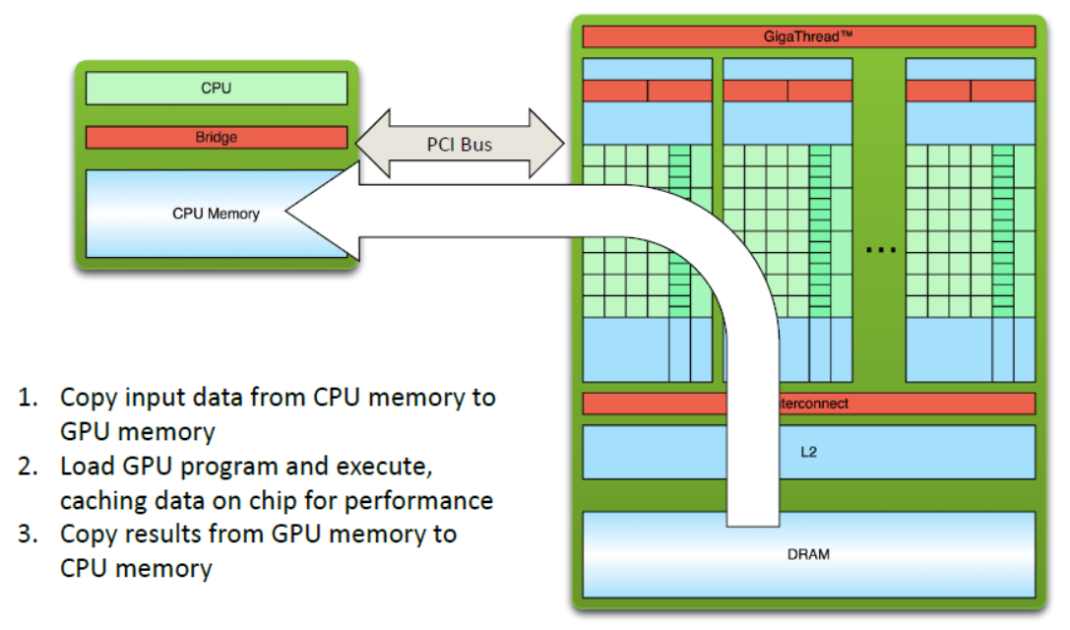
Heterogeneous parallel computing

Slide 35
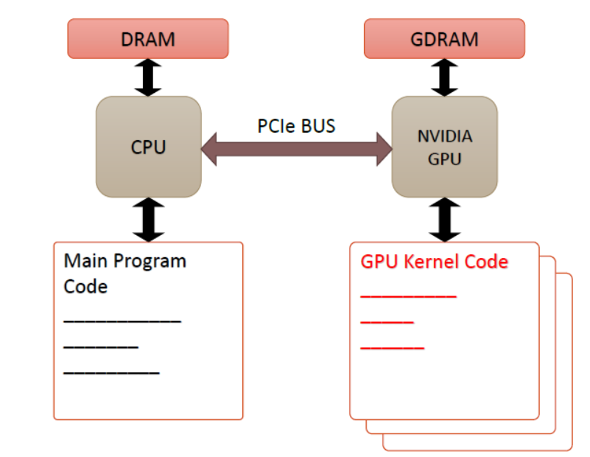
Heterogeneous parallel computing
Host code
Device kernels

Slide 36
Compiling A CUDA Program
Integrated C programs with CUDA extensions
NVCC Compiler
Host Code
Device Code
Host C Compiler/ Linker
Device Just-in-Time Compiler
Heterogeneous Computing Platform with
CPUs, GPUs

Slide 37
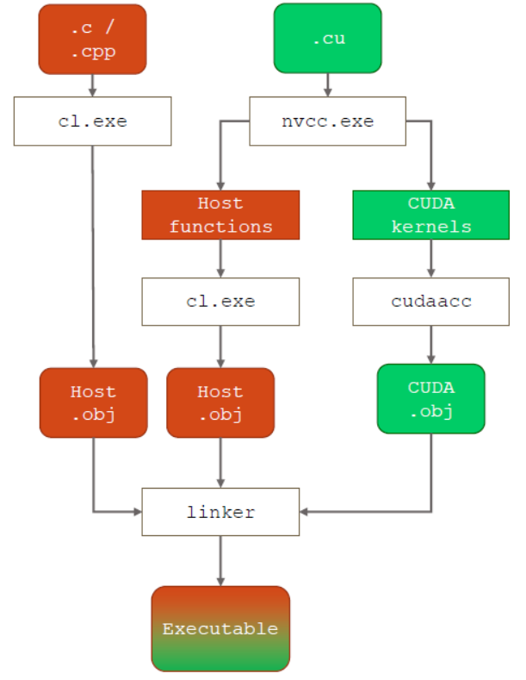
Compiling A CUDA Program (MSVC)
CUDA源文件（*.cu）由nvcc编译器编译。
现有的cuda.rules文件为CUDA源文件创建属性页面。
以与配置C编译器相同的方式配置nvcc。
优化和包含目录等选项可以从项目默认设置中继承。
C和C++文件使用cl（MSVCC编译器）进行编译。

Slide 38
CUDA/OpenCL – Execution Model
Integrated host+device app C program
在host端C代码中中执行串行或轻度并行任务
在设备device端的SPMD内核C代码中执行高并行任务
Serial Code (host)‏
Grid of threads
Parallel Kernel (device)‏
KernelA<<< nBlk, nTid >>>(args);
. . .
Serial Code (host)‏
Grid of threads
Parallel Kernel (device)‏
KernelB<<< nBlk, nTid >>>(args);
. . .
Simplified CUDA model

Slide 39
Content
Data Parallelism
Example – color to grey conversion
CUDA Programming model
CUDA C Structure
Example – vector add
Memory and Data Transfer
Kernel Function
Kernel Launch

Slide 40
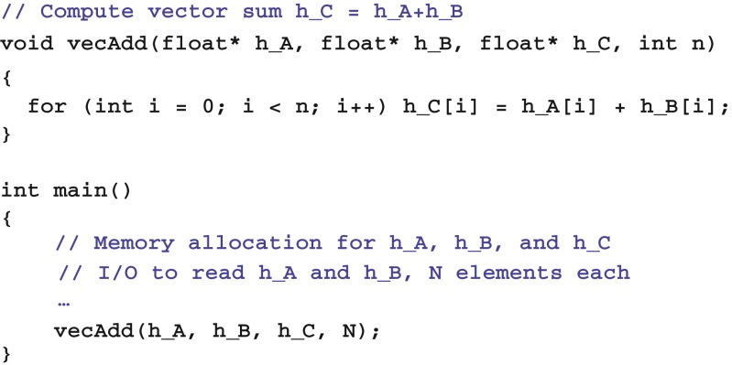
Vector Addition: Traditional
A simple traditional vector addition C code example.

Slide 41
Vector Addition: Traditional
C语言中的指针和数组:
在C语言中，可以使用指针来访问变量和数据结构。可以声明一个指针变量P，其声明方式为 :
float *P;
在C程序中，可以通过指向其第0个元素的指针来访问数组。
例如，语句 P=&(A[0]) 使得P指向数组A的第0个元素.
P[i] becomes a synonym for A[i].
实际上，数组名A本身就是指向其第0个元素的指针.

Slide 42
Vector Addition: Traditional
Pointers and Array in C:
将数组名A作为第一个参数传递给函数调用vecAdd，使得函数的第一个参数h_A指向A的第0个元素。
也就是：A是通过引用（by reference）传递给vecAdd的。
因此，在函数体内可以使用h_A[i]来访问A[i]。

Slide 43
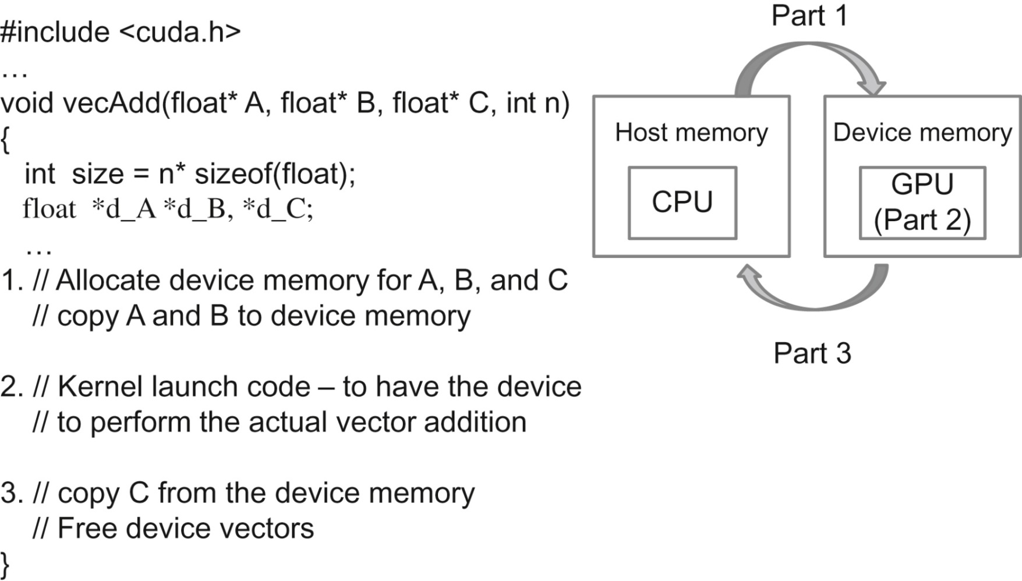
Vector Addition: CUDA
FIGURE 2.6: Outline of a revised vecAdd function that moves the work to a device.

Slide 44
Content
Data Parallelism
Example – color to grey conversion
CUDA Programming model
CUDA C Structure
Example – vector add
Memory and Data Transfer
Kernel Function
Kernel Launch

Slide 45
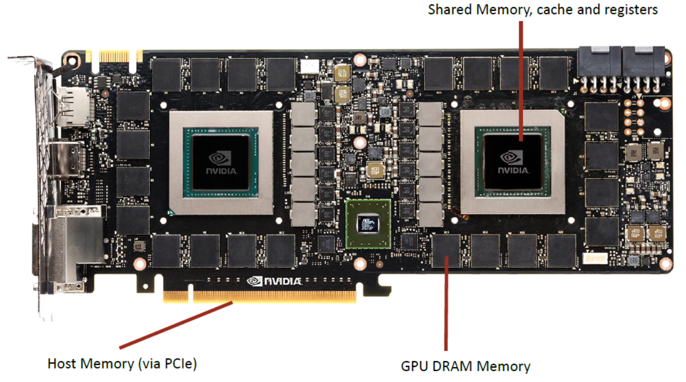
Device Global Memory
Device Memory:
Global Memory

Slide 46
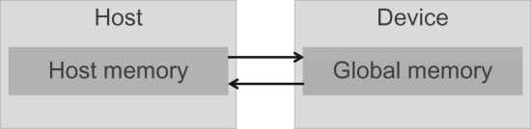
Device Global Memory
Host memory and device global memory:
The device global memory can be accessed by the host to transfer data to and from the device.
Assuming no unified memory space.

Slide 47
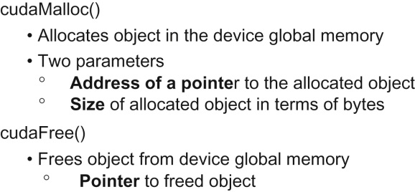
Device Global Memory
CUDA API functions for managing device global memory:
cudaMalloc() is a generic function that is not restricted to any particular type of objects.

Slide 48
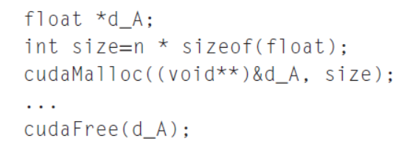
Device Global Memory
cudaMalloc()
The address of the pointer variable should be cast to (void **) because the function expects a generic pointer;
这是一个通用函数，不限制于任何特定类型的对象。

Slide 49
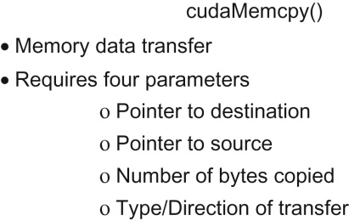
Device Global Memory
CUDA API function for data transfer between host and device:

Slide 50
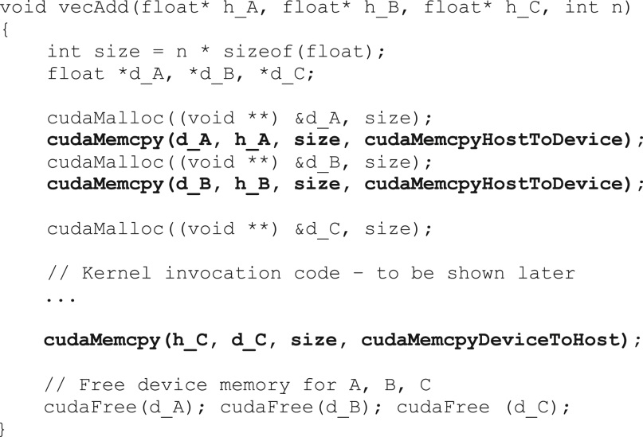
A more complete version of vecAdd()

Slide 51
Error Checking in CUDA
对于程序来说，检查和处理错误是非常重要的。
CUDA API 函数会返回标志，用于指示在处理请求时是否发生了错误。
在实际应用中，我们应该在调用这些函数的代码周围添加检测错误条件的代码，并打印出错误消息，以便用户能够意识到错误的发生。
cudaError_t err=cudaMalloc((void **) &d_A, size);
if (error !=cudaSuccess) {
printf(“%s in %s at line %d\n”, cudaGetErrorString(err),
__FILE__,__LINE__);
exit(EXIT_FAILURE);
}

Slide 52
Content
Data Parallelism
Example – color to grey conversion
CUDA Programming model
CUDA C Structure
Example – vector add
Memory and Data Transfer
Kernel Function
Kernel Launch

Slide 53
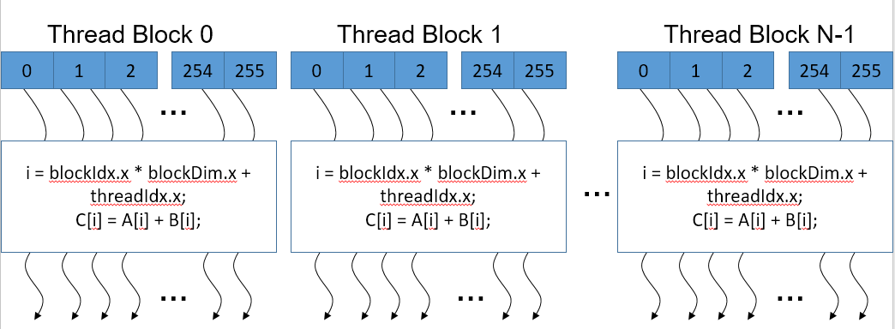
Arrays of Parallel Threads
A CUDA kernel is executed by a grid (array) of threads that are organized into two-level hierarchy.
Each grid is organized as an array of thread blocks.
All threads in a grid run the same kernel code (SPMD)‏
53

Slide 54
Example: Vector Addition Kernel
Device Code
// Compute vector sum C = A+B
// Each thread performs one pair-wise addition
__global__
void vecAddKernel(float* A_d, float* B_d, float* C_d, int n)
{
int i = threadIdx.x + blockDim.x * blockIdx.x;
if(i<n) C_d[i] = A_d[i] + B_d[i];
}
int vectAdd(float* A, float* B, float* C, int n)
{
// A_d, B_d, C_d allocations and copies omitted
// Run ceil(n/256) blocks of 256 threads each
vecAddKernel<<<ceil(n/256.0), 256>>>(A_d, B_d, C_d, n);
}

Slide 55
More on CUDA Function Declarations
Executed on the:
Only callable from the:
__device__ float DeviceFunc()‏
device
device
__global__ void KernelFunc()‏
device
host
__host__ float HostFunc()‏
host
host
__global__ defines a kernel function
Each “__” consists of two underscore characters
A kernel function must return void

Slide 56
More on CUDA Function Declarations
Executed on the:
Only callable from the:
__device__ float DeviceFunc()‏
device
device
__global__ void KernelFunc()‏
device
host
__host__ float HostFunc()‏
host
host
__device__ and __host__ can be used together
这种组合指示编译系统为同一个函数生成两个版本的目标文件
一个在主机上执行，只能由主机函数调用
另一个在设备上执行，只能由设备函数或内核函数调用。

Slide 57
Example: Vector Addition Kernel
Device Code
// Compute vector sum C = A+B
// Each thread performs one pair-wise addition
__global__
void vecAddKernel(float* A_d, float* B_d, float* C_d, int n)
{
int i = threadIdx.x + blockDim.x * blockIdx.x;
if(i<n) C_d[i] = A_d[i] + B_d[i];
}
int vectAdd(float* A, float* B, float* C, int n)
{
// A_d, B_d, C_d allocations and copies omitted
// Run ceil(n/256) blocks of 256 threads each
vecAddKernel<<<ceil(n/256.0), 256>>>(A_d, B_d, C_d, n);
}
Where the loop went?
The answer is that the loop is now replaced with the grid of threads.
The entire grid forms the equivalent of the loop.
Each thread in the grid corresponds to one iteration of the original loop.
Sometimes also referred to as loop parallelism.

Slide 58
Thread Blocks: Scalable Cooperation
将线程数组划分为多个块（block）
块内的线程通过共享内存、原子操作和屏障同步（shared memory, atomic operations and barrier synchronization）来协作
不同块中的线程不能协作
0
1
2
254
255
网格的所有块大小相同；
每个块最多可以包含1024个线程；
线程块的每个维度应该是32的倍数。
…
i = blockIdx.x * blockDim.x + threadIdx.x;
C[i] = A[i] + B[i];
…

Slide 59
Thread Blocks: Scalable Cooperation
Each thread uses indices to decide what data to work on
blockIdx: 1D, 2D, or 3D (CUDA 4.0)
threadIdx: 1D, 2D, or 3D
The variable is of struct type with three unsigned integer fields:
x, y, and z;
Simplifies memory addressing when processing multidimensional data
Image processing
Solving PDEs on volumes
…

Slide 60
Example: Vector Addition Kernel
Device Code
// Compute vector sum C = A+B
// Each thread performs one pair-wise addition
__global__
void vecAddKernel(float* A_d, float* B_d, float* C_d, int n)
{
int i = threadIdx.x + blockDim.x * blockIdx.x;
if(i<n) C_d[i] = A_d[i] + B_d[i];
}
int vectAdd(float* A, float* B, float* C, int n)
{
// A_d, B_d, C_d allocations and copies omitted
// Run ceil(n/256) blocks of 256 threads each
vecAddKernel<<<ceil(n/256.0), 256>>>(A_d, B_d, C_d, n);
}
because not all vector lengths can be expressed as multiples of the block size.
For example, the vector length is 100. Assume that we picked 32 as block size.
Four thread blocks to process all the 100 vector elements.
However, the four thread blocks would have 128 threads.
We need to disable the last 28 threads in thread block 3.

Slide 61
Example: Vector Addition Kernel
// Compute vector sum C = A+B
// Each thread performs one pair-wise addition
__global__
void vecAddKernel(float* A_d, float* B_d, float* C_d, int n)
{
int i = threadIdx.x + blockDim.x * blockIdx.x;
if(i<n) C_d[i] = A_d[i] + B_d[i];
}
int vectAdd(float* A, float* B, float* C, int n)
{
// A_d, B_d, C_d allocations and copies omitted
// Run ceil(n/256) blocks of 256 threads each
vecAddKernel<<<ceil(n/256.0), 256>>>(A_d, B_d, C_d, n);
}
当宿主（Host）代码启动一个内核时，它通过执行配置参数（execution configuration parameters）设置网格和线程块的维度。
第一个配置参数给出了网格中的线程块数量。
第二个参数指定了每个线程块中的线程数量。
Host Code

Slide 62
Content
Data Parallelism
Example – color to grey conversion
CUDA Programming model
CUDA C Structure
Example – vector add
Memory and Data Transfer
Kernel Function
Kernel Launch

Slide 63
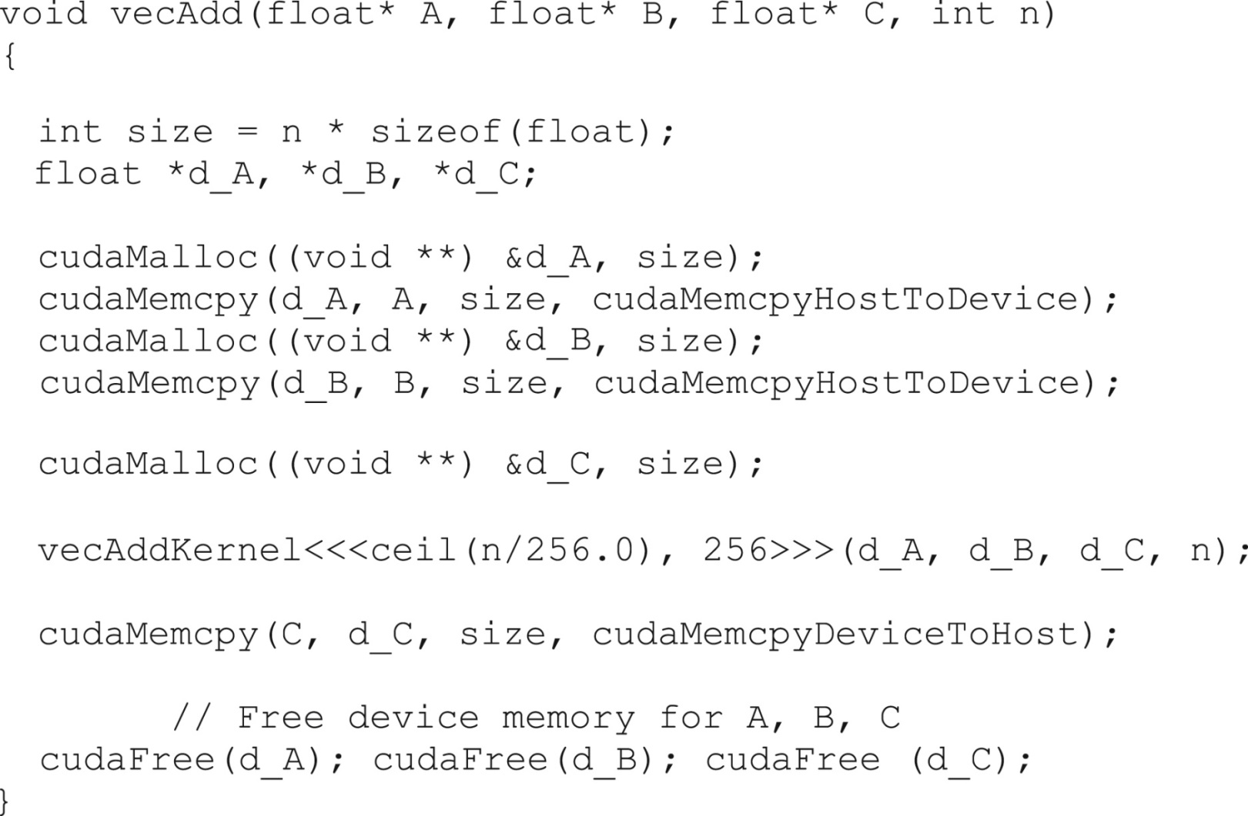
A complete version of the host

Slide 64
More on Kernel Launch
int vecAdd(float* A, float* B, float* C, int n)
{
// A_d, B_d, C_d allocations and copies omitted
// Run ceil(n/256) blocks of 256 threads each
dim3 DimGrid(n/256, 1, 1);
if (n%256) DimGrid.x++;
dim3 DimBlock(256, 1, 1);
vecAddKernel<<<DimGrid,DimBlock>>>(A_d, B_d, C_d, n);
}
Host Code

Slide 65
More on Thread Blocks
使用的线程块数量取决于向量的长度（n）：
如果n是750，将使用三个线程块。
如果n是4000，将使用16个线程块。
如果n是2,000,000，将使用7813个线程块。
所有线程块在向量的不同部分上操作。
它们可以以任何任意顺序执行。
在不同硬件上的执行具有可扩展性：
相同的代码在较小的GPU上运行速度较慢，在较大的GPU上运行速度较快。

Slide 66
Summary
Data Parallelism
Example – color to grey conversion
CUDA Programming model
CUDA C Structure
Example – vector add
Memory and Data Transfer
Kernel Function
Kernel Launch

Slide 67
References
1. An Easy Introduction to CUDA C and C++
By Mark Harris | October 31, 2012
https://devblogs.nvidia.com/easy-introduction-cuda-c-and-c/
2. NVDIA Developer Blog.
https://devblogs.nvidia.com/

Slide 68
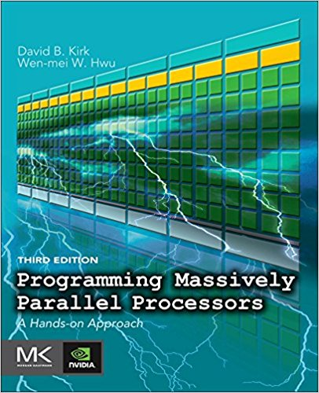
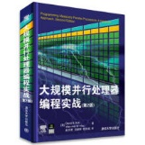
Reference
CUDA C Programming Guide,
https://docs.nvidia.com/cuda/cuda-c-programming-guide/index.html
Programming Massively Parallel Processors,
A Hands-on Approach
Third Edition

Slide 69
Reference
Programming Massively Parallel Processors:
Parallel Models
Data parallel computing
Scalable parallel execution
Memory and data locality
Performance consideration
Numerical consideration
Parallel Patterns
Convolution
Prefix Sum
Parallel Histogram
Sparse Matrix
Merge Sort
Graph Search
Application Case Study
Machine Learning
…
Other topics
…

